Slide 1
Predict clinical outcomes using CT and clinical data
CS 760 Final Project
Lingyun Xiao, Deming Lu

Slide 2
Goal
CT data
Clinical Outcomes
CT data
Clinical Outcomes
Clinical data
Logistic Regression
CT data
Biological Age
Neural
Network
CS 760: Machine Learning

Slide 3
Data Description
CT Data
Clinical Outcomes
Main Dataset
Numeric
Numeric
Categorical
Categorical
Clinical Data
CS 760: Machine Learning

Slide 4
Data Preprocessing
Clinical Outcomes
Categorical
CT Data
Numeric
Min-Max Normalization
Drop Missing values
Clinical Data
Numeric
Min-Max Normalization
Drop Missing values
Categorical
Use Binary values
Drop Missing values
Training 80%
Testing 20%
CS 760: Machine Learning

Slide 5
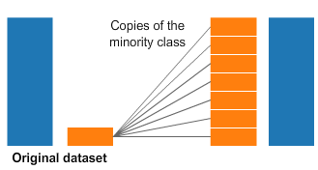
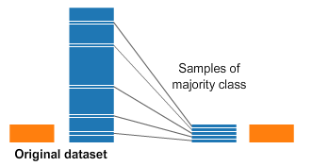
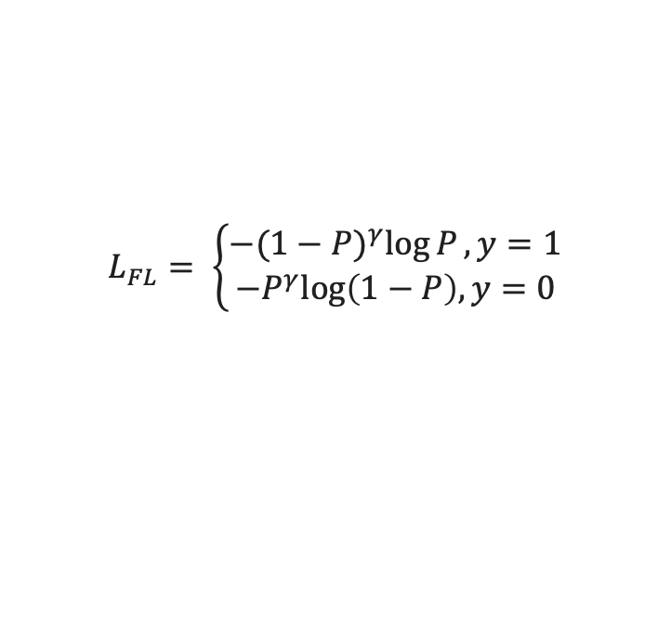
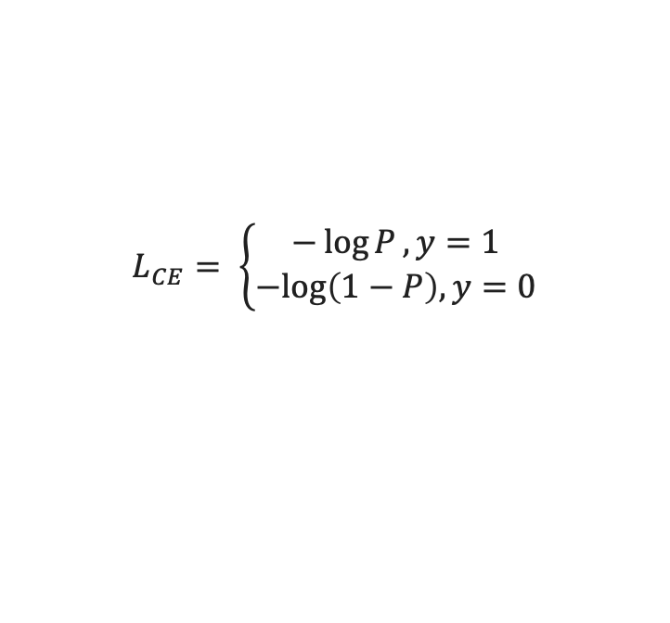
How to Treat Imbalanced Data?
Oversampling
Undersampling
Focal Loss:
Improvement from Cross Entropy Loss
Predict that all patients die
94% Accuracy!
$$L_{CE}= \left\{\begin{aligned}−\log{P}, y=1 \\ −log\left(1−P\right), y=0\end{aligned}\right.$$
$$L_{FL}= \left\{\begin{aligned}−{(1−P)}^{γ}\log{P}, y=1 \\ −P^{γ}log\left(1−P\right), y=0\end{aligned}\right.$$
CS 760: Machine Learning
Notes:
Gamma > 1,
P: the probability that the sample is correctly classified
If P is close to 1, the loss is much smaller for “well-classified” samples. Therefore, focus more on the minority class

Slide 6
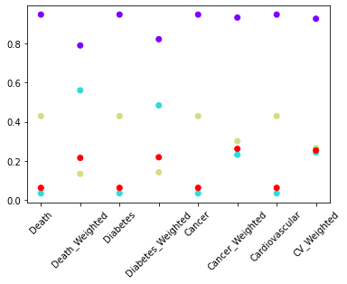
Preliminary Result: Death Prediction with LR
Logistic Regression
Highly Imbalanced Data
Weighted Logistic Regression
Accuracy
Recall
Precision
F1
CS 760: Machine Learning

Slide 7
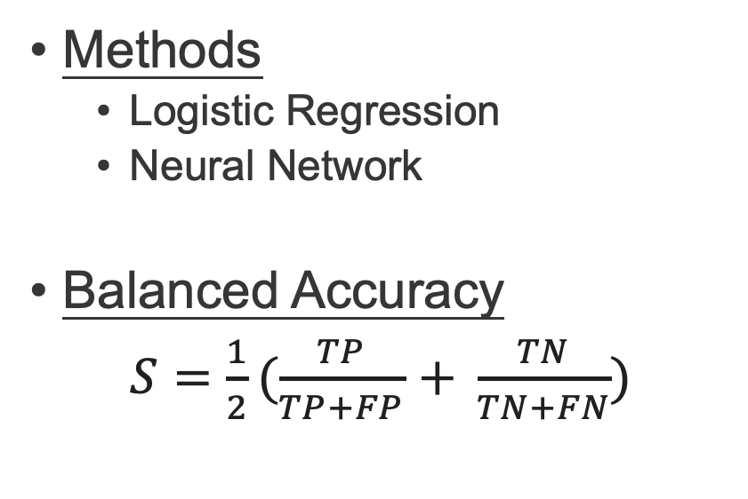
Results: Prediction of death (Classification)
Methods
Logistic Regression
Neural Network
Balanced Accuracy
$S=\frac{1}{2}(\frac{TP}{TP+FP}$ $+ \frac{TN}{TN+FN})$
CS 760: Machine Learning

Slide 8
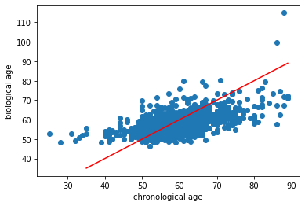
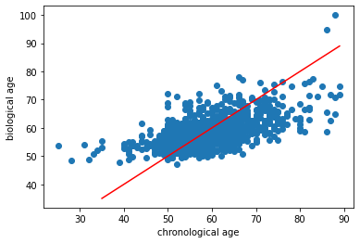
Results: Biological Age Estimation (Regression)
Linear Regression
Neural Networks
CS 760: Machine Learning

